Slide 1


NSDF-Catalog: Lightweight Indexing
Service for Democratizing Data Delivery
Jakob Luettgau¹, Giorgio Scorzelli², Glenn Tarcea⁴, Christine Kirkpatrick⁴, Valerio Pascucci², Michela Taufer¹
¹University of Tennessee Knoxville, ²University of Utah, ³University of Michigan, ⁴San Diego Supercomputing Center
NSF: 2138811 (NSDF) and 2028923 (SOMOSPIE); IBM; XSEDE: TG-CIS210128; Chameleon: CHI-210923
December 9, 2022, Vancouver, Washington, USA
15th IEEE/ACM International Conference on Utility and Cloud Computing
http://nationalsciencedatafabric.org/

Slide 2
Overview and Motivation
Vast amounts of data are produced for scientific purposes
Funding agencies and publishers increasingly require research artifacts
Discovery and usage of these datasets is often not straightforward
As part of the NSF National Science Data Fabric (NSDF) Pilot Project we are developing services and cyberinfrastructure to democratize data delivery
→ Need for global indexing service of available data
within National Science Data Fabric

Slide 3
Overview and Motivation
Vast amounts of data are produced for scientific purposes
Funding agencies and publishers increasingly require research artifacts
Discovery and usage of these datasets is often not straightforward
As part of the NSF National Science Data Fabric (NSDF) Pilot Project we are developing services and cyberinfrastructure to democratize data delivery
→ Need for global indexing service of available data
within National Science Data Fabric
→ Index is useful also beyond our mission as starting point
for researchers and students to discover related data!

Slide 4
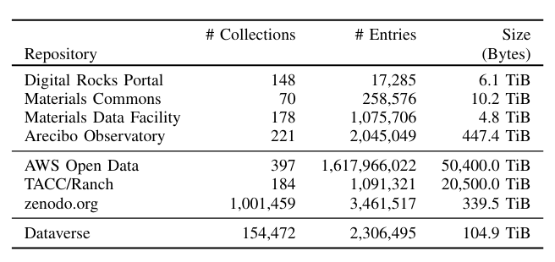
NSDF-Catalog: Examples of Public Data Repositories
?
?
?
?
?
?

Slide 5
NSDF-Catalog: Examples of Public Data Repositories
?
?
?
?
?
?
45+ independent repositories by operated by different domain communities or institutions

Slide 6
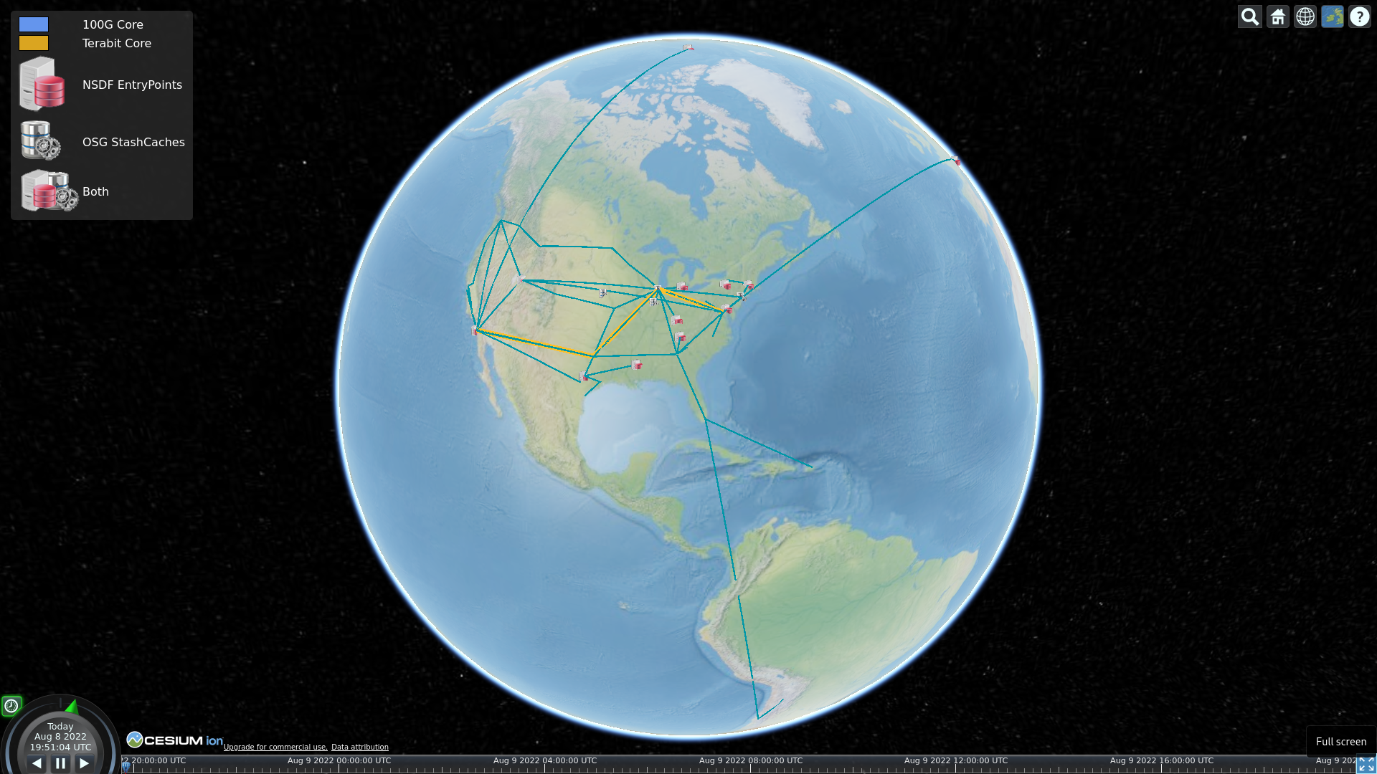

IceCube
PRISMS Materials Commons UMICH
XenonNT
LLNL
UTAH/SCI
CHESS/Cornell
MCC
CHPC
MGHPCC + OSN
JHU
Internet2
SDSC + OSG
SNL
UTK
UTEP
MS-CC
TACC
JSUMS
XSEDE/ACCESS
IBM Cloud
Jetstream2
CloudBank (AWS, Azure, …)
CloudLab
Chameleon
CyVerse
Integrate across a wide range of stakeholders and systems. From classrooms, to cloud, and HPC.
Notes:
The NSDF pilot supports the IceCube neutrino observatory and the XenonNT dark matter detector advances the understanding of the evolution of galaxies and the nature of “dark matter” and “dark energy.

Slide 7

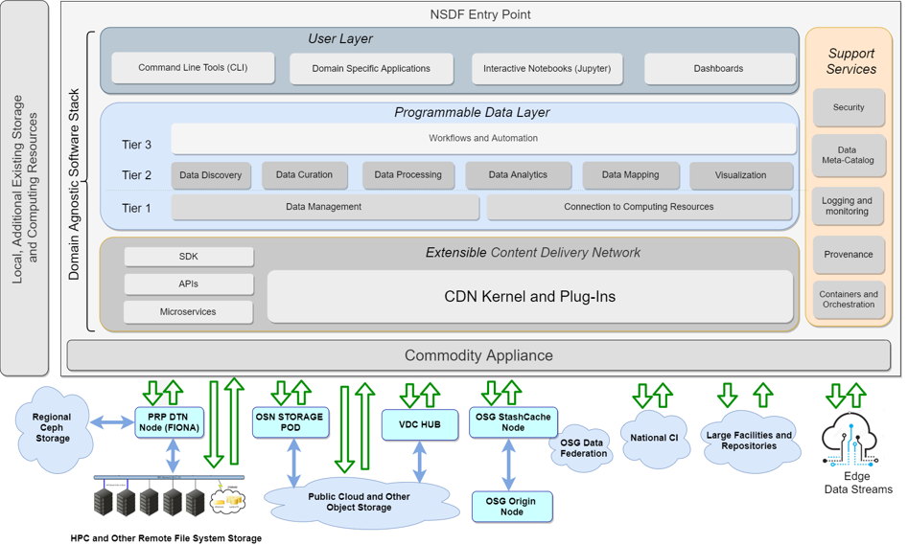
The IDEA of NSDF:
Provide an easy to deploy software-
stack, as an Entry Point to allow
connecting and interacting with wide
range of research infrastructure.
Notes:
Now with this kind of surface area to countless services.. We end up with a relatively complicated software stack
But the abstraction that we envision for this is that of an “Entry Node”..
Which normalizes

Slide 8
Entry
Point
Scientists Educators
Students
Application Developers
Middleware/Service Developers
Infrastructure
Providers

Slide 9
Entry
Point
Scientists Educators
Students
Application Developers
Middleware/Service Developers
Infrastructure
Providers
HPC
Commercial
Clouds
Science
Clouds/Grids

Slide 10
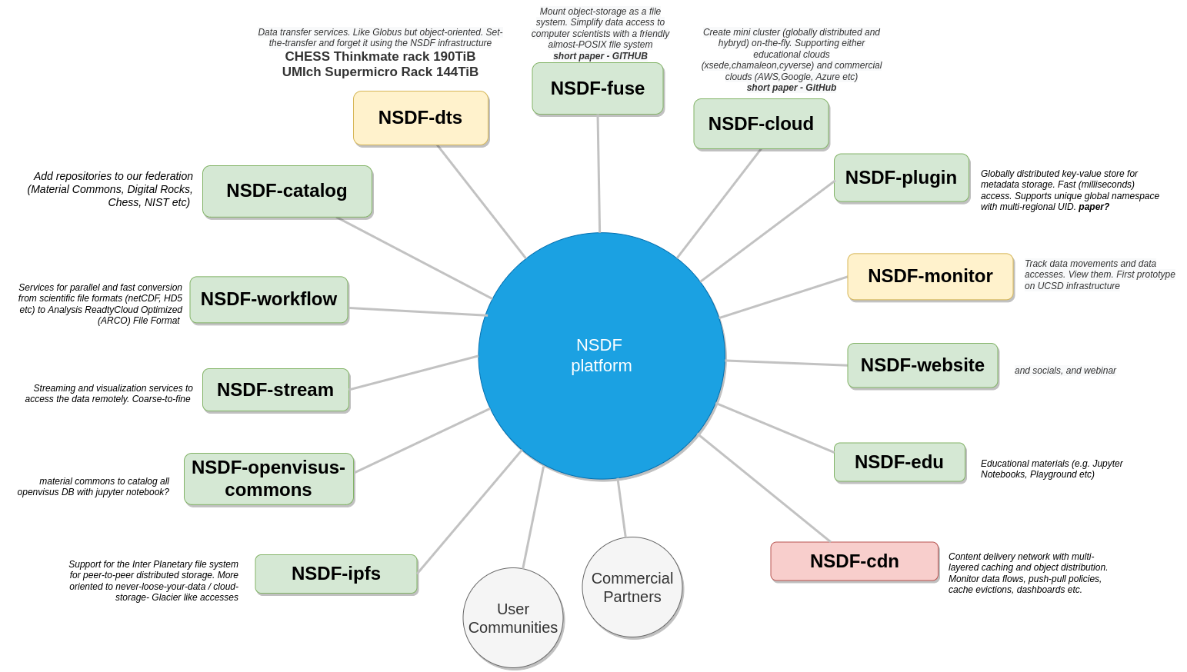
Services &
Building Blocks
Notes:
And on the other hand we have to idneitify the core services and building blocks that are currently often missing or elusive especially for organizations that haven’t been using advanced research infrastructure for decades

Slide 11
Services &
Building Blocks
Mapping object storage into POSIX namespaces for legacy support
Transfer Abstraction
with, e.g,, Globus or xrootd
Common APIs across cloud providers
Data Inventory and Discovery
System and Network Utilization &
Optimization

Slide 12
Services &
Building Blocks
Mapping object storage into POSIX namespaces for legacy support
Transfer Abstraction
with, e.g,, Globus or xrootd
Common APIs across cloud providers
Data Inventory and Discovery
System and Network Utilization &
Optimization

Slide 13
NSDF-Catalog: Challenges
High-Level Objectives
Support different repositories providers
Potentially trillions of datasets, files, or objects
Containerized for easy maintenance and scaling
Federated for efficient indexing and to offer users and providers control over their data
Open Research Questions
What are the operational requirements?
For Harvesting?
For Serving Users?
What are optimization opportunities?
For scientific data management?
For specific research communities?
For data movements within NSDF?

Slide 14
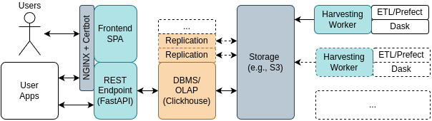
NSDF-Catalog: Architecture
High-Level Objectives
Support different repositories providers
potentially trillions of datasets, files, or objects
Containerized for easy maintenance and scaling
Federated for efficient indexing and to offer users and providers control over their data

Slide 15
NSDF-Catalog: Architecture

Slide 16
NSDF-Catalog: Architecture

Slide 17
NSDF-Catalog: Architecture

Slide 18
NSDF-Catalog: Many Open Operational and Research Questions
Query Performance for common use-cases?
Expected Harvesting Rate and Harvester Hardware Requirements?
API and User-Interfaces?
Ingest Performance?
Affordable Index-Size and Fragmentation Strategies?

Slide 19
Query Performance for common use-cases?
Expected Harvesting Rate and Harvester Hardware Requirements?
API and User-Interfaces?
Ingest Performance?
Affordable Index-Size and Fragmentation Strategies?

Slide 20
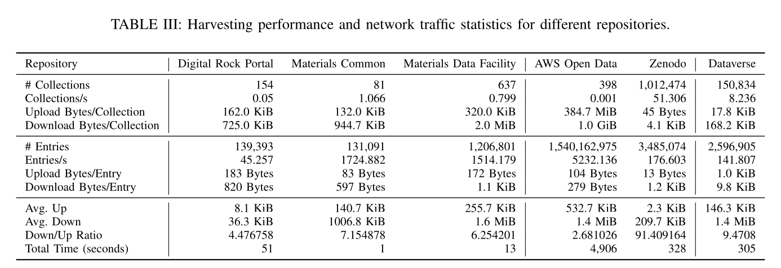
Harvesting Performance and Network Traffic Analysis
Entries/s fetched from different repository provider vary a lot
→ We would greatly benefit from a standard and batched queries

Slide 21
Harvesting Performance and Network Traffic Analysis
Entries/s fetched from different repository provider vary a lot
→ We would greatly benefit from a standard and batched queries
Request data send and received not always in favorable ratio

Slide 22
Harvesting Performance and Network Traffic Analysis
Entries/s fetched from different repository provider vary a lot
→ We would greatly benefit from a standard and batched queries
Request data send and received not always in favorable ratio (because they batch)

Slide 23
Harvesting Performance and Network Traffic Analysis
Entries/s fetched from different repository provider vary a lot
→ We would greatly benefit from a standard and batched queries
Request data send and received not always in favorable ratio (because they batch)
Different repositories require different harvesting strategies

Slide 24
Query Performance for common use-cases?
Expected Harvesting Rate and Harvester Hardware Requirements?
API and User-Interfaces?
Ingest Performance?
Affordable Index-Size and Fragmentation Strategies?

Slide 25
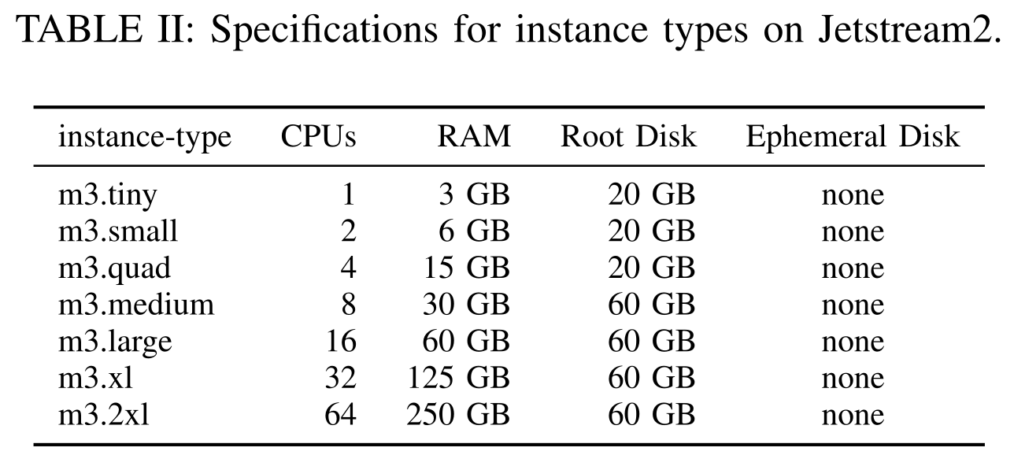
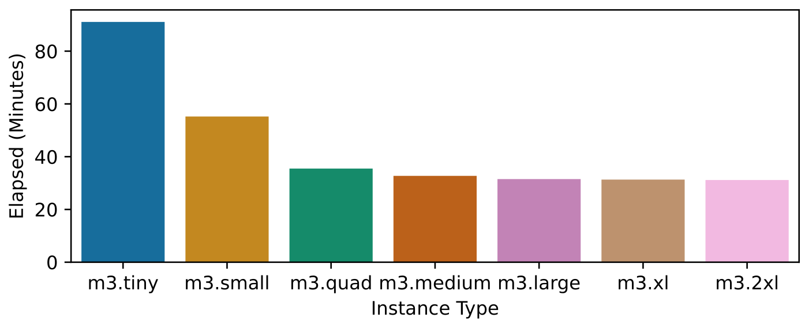
Detailed Ingest Performance for different Instances Types
Scenario: Single worker processing queue of around 1800 CSV files
More cores yield higher ingest rates…
BUT: benefit of larger instance types is reduced after 8+ CPUs

Slide 26
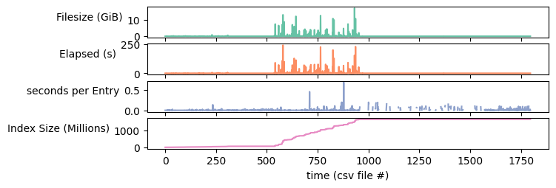
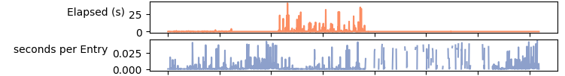
Investigation of Ingest Rates at CSV Granularity
Time taken for each CSV via CLI-Import
→ Clickhouse does parallelize import but CSV files need to be large enough
→ Many repositories are relatively small
m3.tiny
m3.2xl

Slide 27
Investigation of Ingest Rates at CSV Granularity
Time taken for each CSV via CLI-Import
→ Clickhouse does parallelize import but CSV files need to be large enough
→ Many repositories are relatively small
m3.tiny
10x
m3.2xl

Slide 28
Query Performance for common use-cases?
Expected Harvesting Rate and Harvester Hardware Requirements?
API and User-Interfaces?
Ingest Performance?
Affordable Index-Size and Fragmentation Strategies?

Slide 29
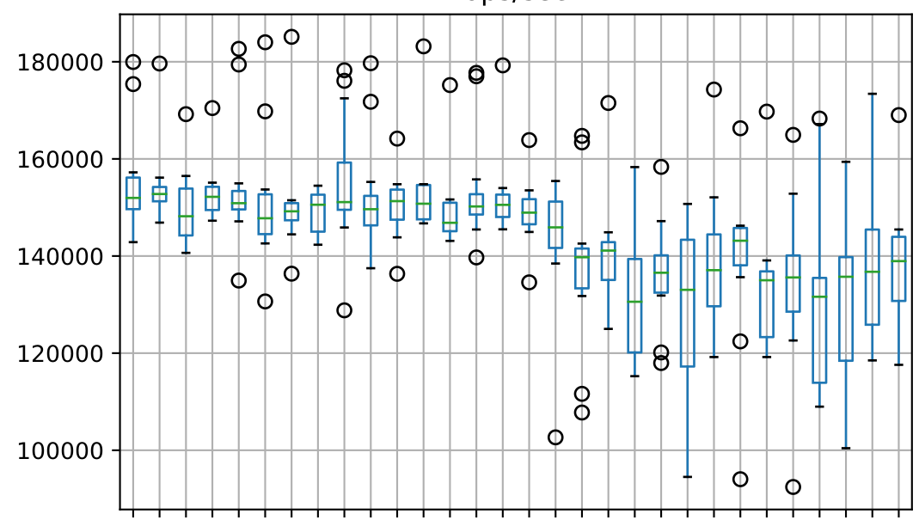
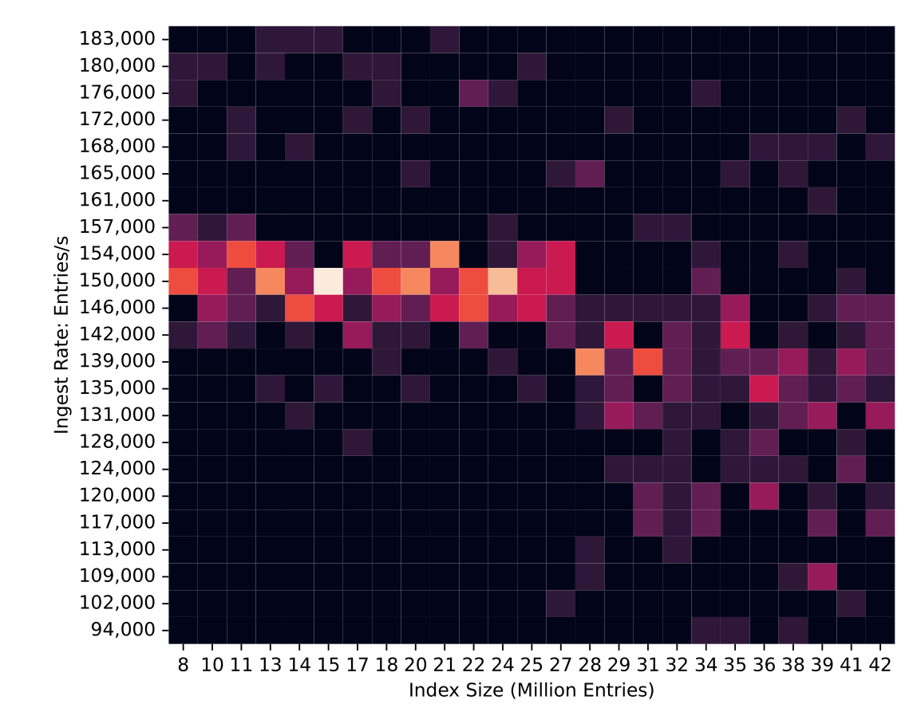
Ingest Performance under Storage Capacity Constraints
How many entries can we accommodate in the smallest instance type?
M3.tiny instance with 20 GiB disk capacity
Slows down after 27 million
Allows up to 42 million records

Slide 30
Ingest Performance under Storage Capacity Constraints
How many entries can we accommodate in the smallest instance type?
M3.tiny instance with 20 GiB disk capacity
→ As the index grow we observe a degradation in ingest performance
!?

Slide 31
Ingest Performance under Storage Capacity Constraints
How many entries can we accommodate in the smallest instance type?
M3.tiny instance with 20 GiB disk capacity
→ As the index grow we observe a degradation in ingest performance
Explanation:
Clickhouse’s MergeTree Engine trigger internal compactification routines as the index grows
!?

Slide 32
Query Performance for common use-cases?
Expected Harvesting Rate and Harvester Hardware Requirements?
API and User-Interfaces?
Ingest Performance?
Affordable Index-Size and Fragmentation Strategies?

Slide 33
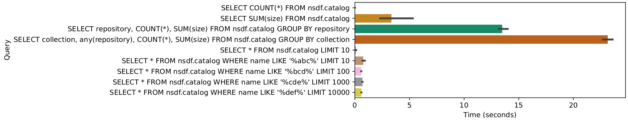
Establishing a Benchmark Set of Queries for NSDF-Catalog
Three Main Categories:
GroupBy for statistics to inform research and development
Individual element queries for NSDF Services
Search queries from Web-User or API-User

Slide 34
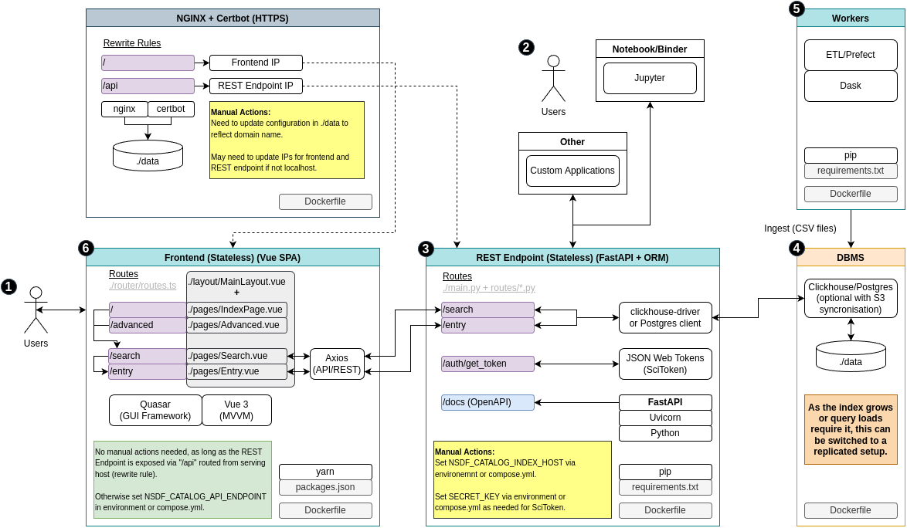
NSDF-Catalog: Architecture Overview

Slide 35
NSDF-Catalog: Challenges
High-Level Objectives
Support different repositories providers
potentially trillions of datasets, files, or objects
Containerized for easy maintenance and scaling
Federated for efficient indexing and to offer users and providers control over their data
Open Research Questions
What are the operational requirements?
For Harvesting?
For Serving Users?
What are optimization opportunities?
For scientific data management?
For specific research communities?
For data movements within NSDF?

Slide 36
NSDF-Catalog: Filling the Voids
?
?
?
?
?
?

Slide 37
NSDF-Catalog: Filling the Voids

Slide 38
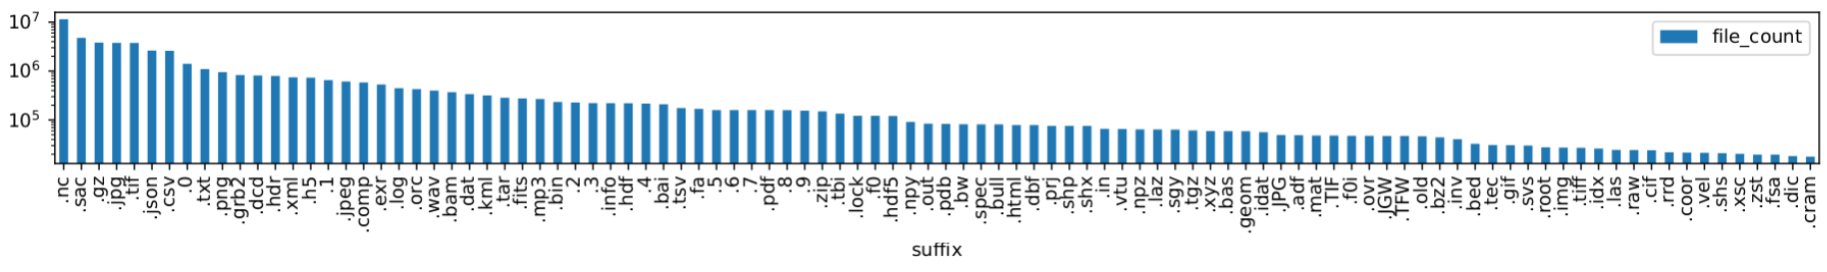
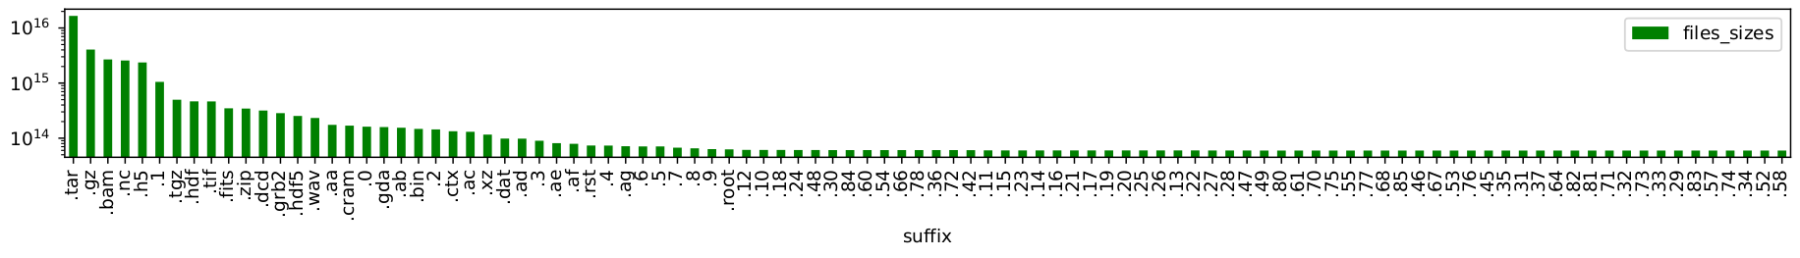
NSDF-Catalog: Common File-Extensions Across Repositories
Many formats with sub-structure due to use of self-describing data formats (HDF5, NetCDF, …) and archives (zip, tar)
count
count

Slide 39
NSDF-Catalog: Common File-Extensions Across Repositories
Many formats with sub-structure due to use of self-describing data formats (HDF5, NetCDF, …) and archives (zip, tar)
count
_
count

Slide 40
NSDF-Catalog: Common File-Extensions Across Repositories
Many formats with sub-structure due to use of self-describing data formats (HDF5, NetCDF, …) and archives (zip, tar)
Checkpointed data (e.g., simulations: *.1, *.2, …) is common and typically large
count
count

Slide 41
Query Performance for common use-cases?
Expected Harvesting Rate and Harvester Hardware Requirements?
API and User-Interfaces?
Ingest Performance?
Affordable Index-Size and Fragmentation Strategies?

Slide 42
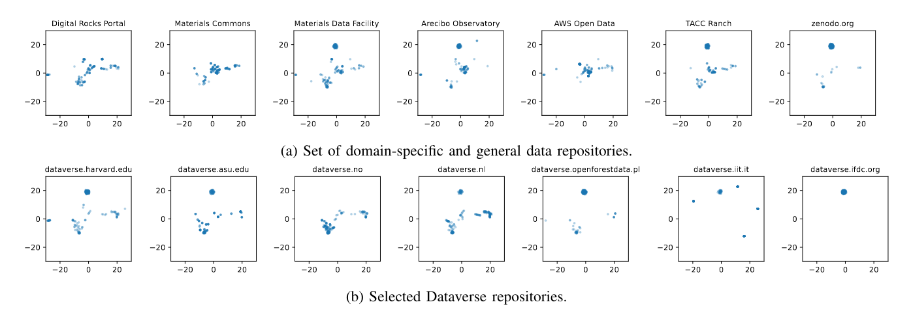
NSDF-Catalog: Finding Similarities Across Research Repositories
Clustering based on distribution of file-sizes in collections

Slide 43
NSDF-Catalog: Finding Similarities Across Research Repositories
Clustering based on distribution of file-sizes in collections

Slide 44
NSDF-Catalog: Finding Similarities Across Research Repositories
Clustering based on distribution of file-sizes in collections

Slide 45
NSDF-Catalog: Finding Similarities Across Research Repositories
Clustering based on distribution of file-sizes in collections

Slide 46
NSDF-Catalog: Finding Similarities Across Research Repositories
Clustering based on distribution of file-sizes in collections

Slide 47

Summary
Building a lightweight index for large amounts of scientific data is feasible spread across a variety of different existing repositories
There is structure across catalogs that can be leveraged to improve search and also to optimize performance for the National Science Data Fabric
Find out more about NSDF-Catalog:
http://nationalsciencedatafabric.org/
http://github.org/nsdf-fabric

